Slide 1
Final Project (Machine Learning Graz): Bank marketing campaigns dataset analysis # Opening a Term Deposit
Lukas Holder
Rudolf Grünbichler
Graz, 30.7.2020
Notes:
https://www.kaggle.com/volodymyrgavrysh/bank-marketing-campaigns-dataset/data

Slide 2
Summary Project Guidelines
Use Public Datasets only!
Answer at least 5 self-imposed Questions on the dataset. If you do it in groups of 2, then at least 10.
Build a Machine Learning Model
The project should be in Python
Describe your working steps in all the python notebooks.
(Optional, but Recommended) Create a presentation of your findings. Put them in the /report folder,
Final Project needs to be submitted on Github.

Slide 3
Agenda
Self-imposed questions
Procedure for data cleaning and data preparation
Machine Learning Model

Slide 4
Self-imposed questions on the dataset

Slide 5
Explanation of the procedure for setting up self-imposed questions
Step 1: Download the dataset from the Website https://www.kaggle.com/volodymyrgavrysh/bank-marketing-campaigns-dataset/data
Step 2: Get an overview and impression of the data in Microsoft Excel
Step 3: Get information from the website about the dataset and the column labels
Step 4: Formulating hypotheses; making assumptions about relationships and differences between the features
Step 5: Start processing the data set with Pandas (See Procedure for data cleaning and data preparation)

Slide 6
Question 1
Is there a difference in the duration of a call, whether the call is made by mobile phone or telephone?
Assumption: Telephone is used for longer
Features: Duration and Contact
Effect: The call duration has an effect on the working time of the hotline staff. If both numbers are available from the customer, the one that takes less time should be called.

Slide 7
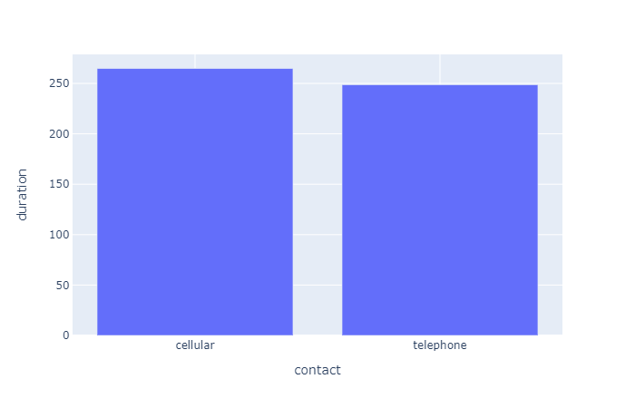
Answer to Question 1
It turns out that the mobile phone is used longer than the telephone. Hotline employees should therefore prefer the telephone to the mobile phone number if both numbers are available.

Slide 8
Question 2
Is there a difference in terms of education and property acquisition?
Features: Education and Housing
Assumption: The higher the level of education, the more likely it is that real estate property (possibly with a mortgage) will be acquired.

Slide 9
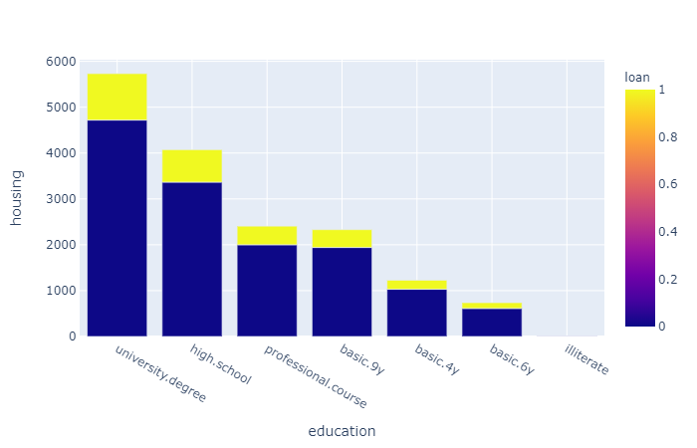
Answer to Question 2
The data show that customers with a university degree (or in general: with a higher educational level) are more likely to have property associated with a housing loan than other educational levels.

Slide 10
Question 3
Is there a difference in terms of marital and property acquisition?
Features: Marital and Housing
Assumption: Married people are more likely to buy a property (with a mortgage).

Slide 11
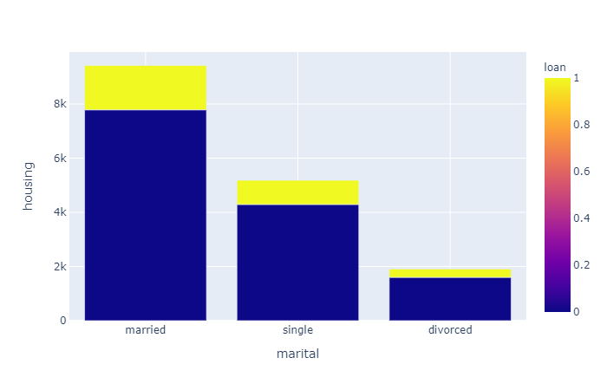
Answer to Question 3
It turns out that married customers are more likely to buy property which are secured by a mortgage. The assumption is that the properties are not self-financed.

Slide 12
Question 4
There is a correlation between the last contact duration and the outcome of the previous marketing campaign.
Features: Duration and Poutcome
Assumption: It is assumed that the longer the last contact was, the more likely it is that the sale will be successful. This could be due to the fact that the conversation is better remembered by the customer and he or she places a deposit.

Slide 13
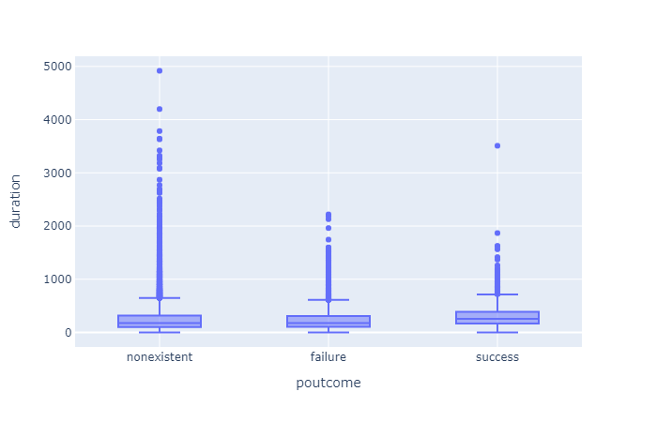
Answer to Question 4
In this case, the graph shows that the duration of the last contact had little influence on the success or failure in the last advertising campaign.

Slide 14
Question 5
There is a connection between age and the sale of a product or service.
Features: Age and Poutcome
Assumption: The younger the person is, the more likely he or she is to be able to sell something, as in this case making a term deposit.

Slide 15
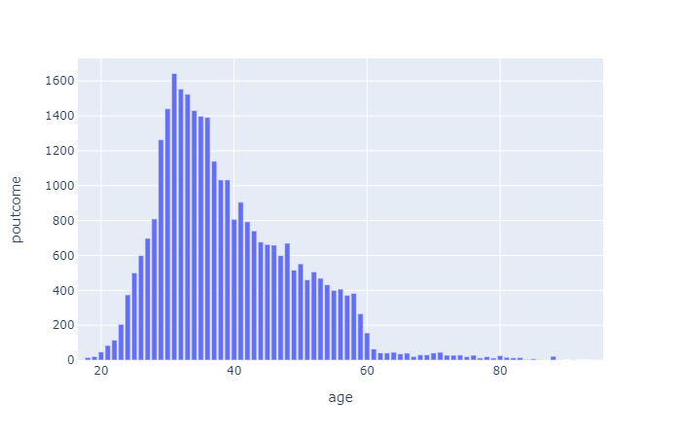
Answer to Question 5
The data of the past campaign show that younger people are more likely to make an deposit than older people. This could be related to the fact that younger people can sell more and are less sceptical than older people or that they want to invest money for the future.

Slide 16
Question 6
There is a connection between loan and placing a deposit.
Features: Loan and Poutcome
Assumption: If a loan exists, the money is used to repay the loan and not used for a term deposit
Effect: If a customer has a credit, the conversation should be shorter. Hotline staff should focus more on customers who do not have credit.

Slide 17
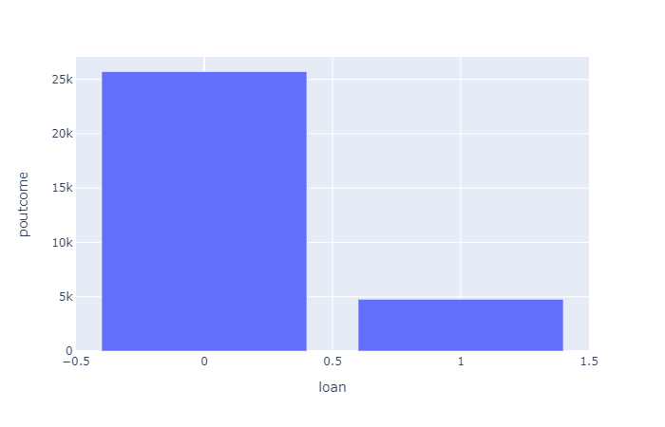
Answer to Question 6
The data show very strongly that success can be achieved with customers without loans. Hotline employees should therefore focus their advertising calls on those customers who do not have a loan.

Slide 18
Question 7
There is a difference in the length of time with whom you call.
Features: Job and Duration
Assumption: People with certain jobs have longer or shorter time to make phone calls.

Slide 19
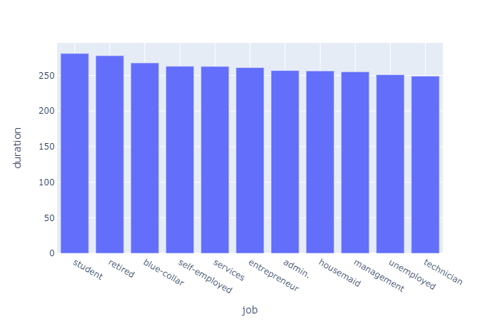
Answer to Question 7
It turns out that for technicians, the most important messages have to be transmitted quickly, as the telephone time is usually shorter. Students and retired persons phone longer. For these groups, the consultation can also be longer.

Slide 20
Question 8
There is a correlation between the interest rate of the 3-month Euribor and the deposit of a term deposit in the last campaign.
Features: Euribor3M and Poutcome
Assumption: The higher the interest rate, the more likely it is that success will occur, i.e. people will be more willing to invest money for a certain period of time.

Slide 21
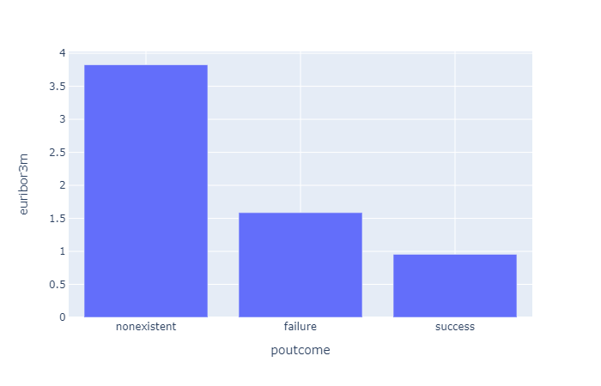
Answer to Question 8
It turns out that higher interest rates do not necessarily lead to the investment of money. At least, the figures from the last advertising campaign do not indicate this.

Slide 22
Question 9
There is a negative correlation with payment difficulties and the conclusion of a cash investment variant.
Features: Default and Poutcome
Assumption: Someone who is in default with the loan will probably not make a term deposit (in general).

Slide 23
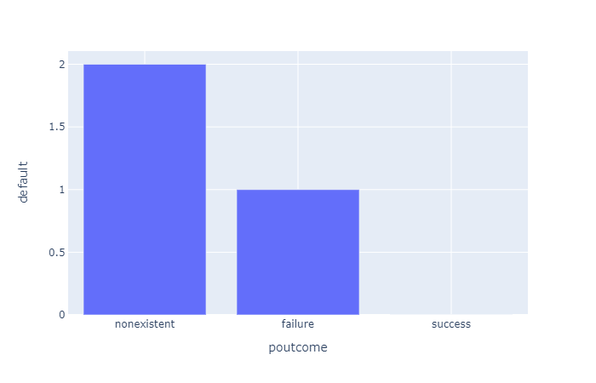
Answer to Question 9
The data from the last advertising campaign show that when customers default on loan instalments, the advertising campaign is not effective and there is a tendency not to make term deposits. This can probably be attributed to the fact that these people have no money to invest.

Slide 24
Question 10
There is a correlation between the frequency of contact and placing a deposit.
Features: Previous and Poutcome
Assumption: It is assumed that the more often contact is made with the customer, the more likely he or she places a deposit.

Slide 25
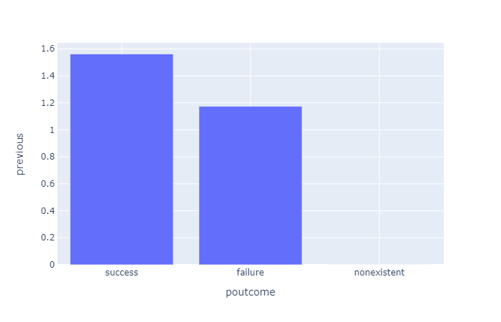
Answer to Question 10
The data show that the more frequently contact is made with the customer, the more likely it is that the advertising campaign will be successful. The success is measured here in the placing of a deposit.

Slide 26
Procedure for data cleaning and data preparation

Slide 27
Column Removal
Since the introduction of dummy variables massively extends the dataset, the hypotheses were used to determine which columns are not needed.
For this purpose the following three columns have been deleted:
Month: The information in which month the last contact with the customer was, is not considered relevant in this case. In Austria, months with special payments could have an impact on a deposit.
Day_of_week: The last contact day of the week is also assumed to have no influence on the target variable.
Emp.var.rate: No influence of the employment variation rate on the target variable is assumed. In this context the data could not be interpreted meaningfully. The upper part of the data contained dates or, when displayed as a number, five-digit ranges, while the lower part of the data contained low-digit numbers. The persons responsible should be consulted in this case.

Slide 28
Line Removal
Checking which rows contain empty cells shows that this is the case for those:
Job (330)
Marital (80)
Education (1.731)
Default (8.597)
Housing (990)
Loan (990)
Due to the large number of records, all lines with the entry "Unkown" were deleted. This led from about 40,000 entries to almost 30,000 entries. It is assumed that this is sufficient for the model.
One possibility would be to apply a model with forecast to the feature "Default". However, this has not been done, as an effect on success is suspected (See self-imposed Questions).

Slide 29

Data Preparation
Other data preparation steps that were carried out:
Deleting duplicates.
Binary inputs were replaced with the values 0 and 1.
Date values were formatted accordingly.
Converting values of the columns into numbers, which were previously strings. For example:

Slide 30
Build a Machine Learning Model: Classification

Slide 31
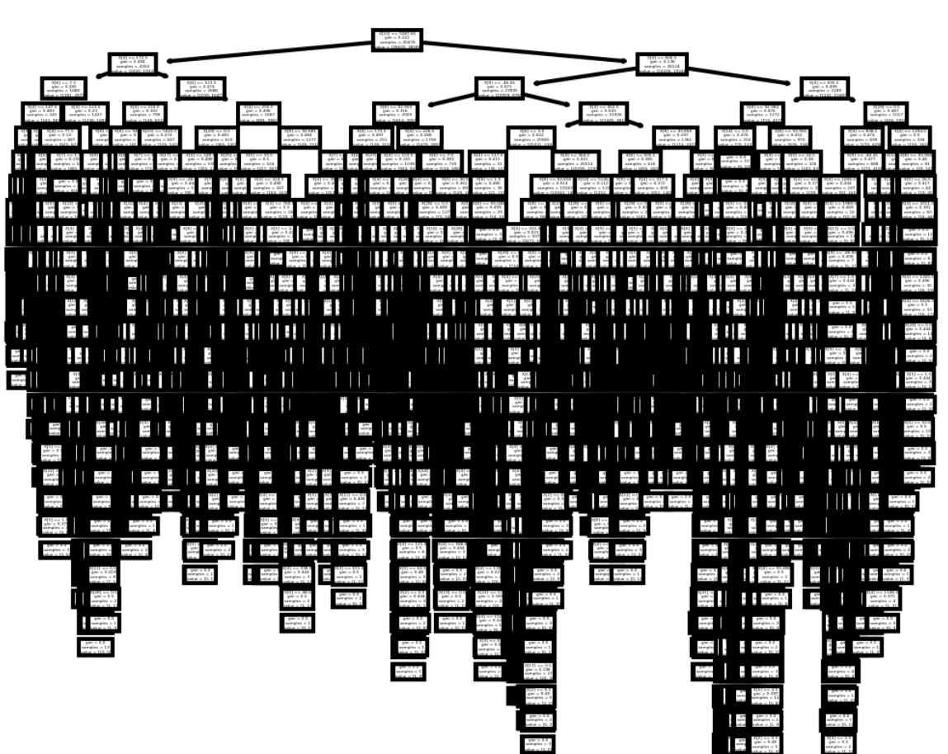
The model used: DecisionTreeClassifier
The model was displayed in Python Pandas and is available on Github.
The evaluation of the model yields the following values:
Accuracy: 87,5%
Precision Score: 51,47%
Recall Score: 55,78%
F1 Score: 53,54%
The model thus provides justifiable forecasts.

